Slide 1

FrontEnd Web Development
Topics Covered:
Web Fundamentals → HTML5, CSS3, JavaScript ES6+
React → Components, Hooks, Routing, State Management
Web Components → Shadow DOM, reusable UI
Testing → Jest, React Testing Library, Cypress/Playwright
RESTful APIs → Frontend-Backend Integration
Authentication & Authorization → JWT, OAuth2
Performance Optimization → Lazy Loading, Memoization
UML & System Design → Client-Server Architecture
Presentation By Magesh J
28/10/2025

Slide 2

Introduction to Frontend Development
“Frontend Development is the art of bringing ideas to life on the web — transforming design and code into beautiful, interactive user experiences.”
🧠 What It Is:
Frontend Development focuses on building the visible and interactive part of websites and web apps — everything users see, click, and interact with in their browsers.
💻 Core Technologies:
HTML – Structure
CSS – Style
JavaScript – Interactivity
🚀 Goal:
To create fast, responsive, and visually appealing web interfaces that deliver an exceptional user experience across all devices.

Slide 3

Web Development
Basics
Definition:
Web fundamentals form the base of frontend development — structure, style, and behavior.
Core Layers:
HTML5: Structure & content
CSS3: Styling & layout
JavaScript (ES6+): Interactivity & logic
Goal: Create responsive, accessible, and dynamic web interfaces.

Slide 4
HTML 5
Key Features:
Semantic elements: <header>, <section>, <footer>
Multimedia: <video>, <audio>
Form enhancements: <input type="email">, <datalist>
Offline support: LocalStorage, Web Storage
Example:
<article>
<h2>Modern HTML5</h2>
<p>HTML5 makes web structure semantic and accessible.</p>
</article>

Slide 5

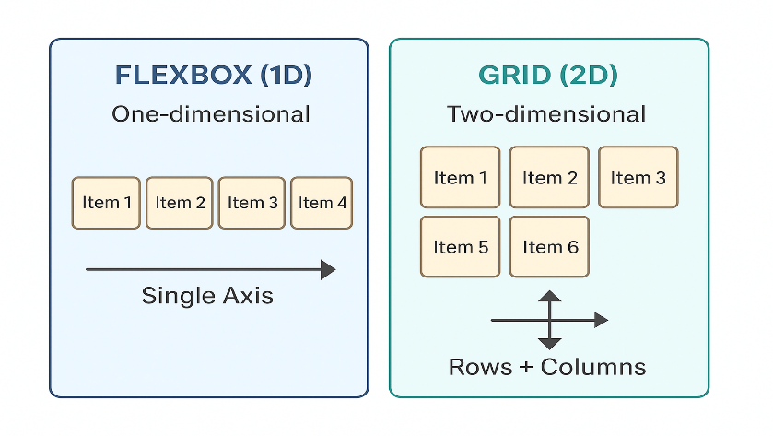
CSS3 (Flexbox & Grid)
Purpose: Defines layout and responsive design.
Flexbox:
1D layout for aligning items horizontally or vertically.
Grid:
2D layout for complex page structures.

Slide 6
JavaScript ES6+
Purpose: Adds logic and interactivity to web pages.
New ES6 Features:
let / const: Safer variable declarations.
Arrow functions: const add = (a,b) => a+b;
Template literals: `Hello ${user}`
Destructuring: const {name, age} = user;
Modules: import / export for reusability.
Promises & async/await for async tasks.

Slide 7

React Basics
React.js: A library for building component-based UIs.
Core Concepts:
Components: Reusable, independent UI blocks.
JSX: Combines HTML and JS.
Virtual DOM: Improves rendering performance.

Slide 8
React Hooks & State Management
Hooks are built-in functions to manage logic inside functional components.
Common Hooks:\
useState() — for dynamic data
useEffect() — for lifecycle events
useContext() — for shared global data
State Management Tools:
Context API: For small apps.
Redux / Zustand: For large-scale data sharing.

Slide 9
Routing in React
Purpose: Handle page navigation in single-page apps.
React Router Concepts:
<BrowserRouter> — wrapper for routes.
<Routes> — define pages.
<Link> — navigate without refresh
Use Case: Build SPAs like dashboards or portfolios.

Slide 10

Web Components
Definition: Native browser technology for creating reusable UI elements.
Core Concepts:
Custom Elements: Define your own HTML tags.
Shadow DOM: Encapsulates styles and logic.
Templates: Define reusable layouts.
Benefit: Works with any framework or vanilla JS.

Slide 11

Testing Tools
Why Testing?
To ensure UI components behave correctly and prevent bugs.
Tools:
Jest: Unit testing framework.
React Testing Library: Tests component rendering.
Cypress/Playwright: Automated end-to-end testing.

Slide 12
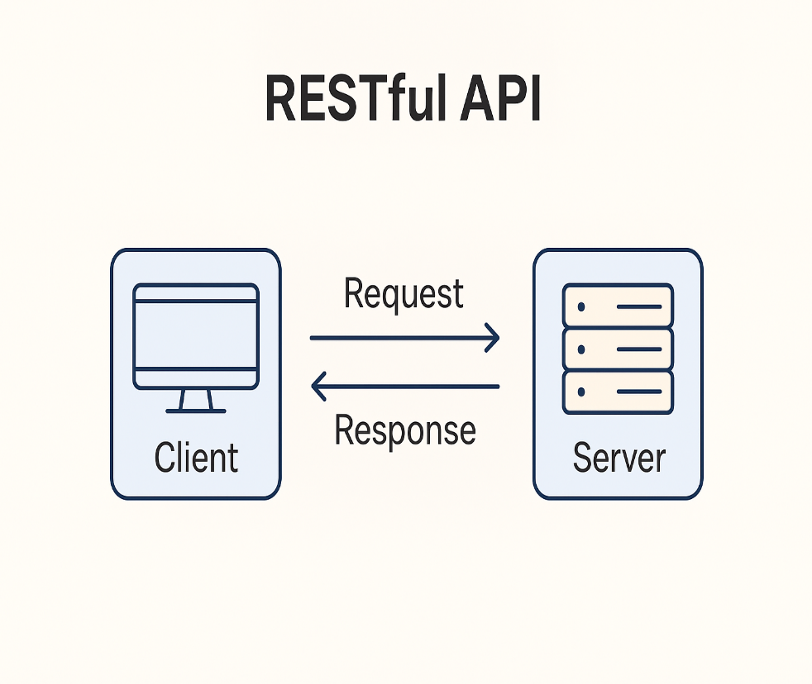
RESTful APIs
Definition: Interface for client-server communication using HTTP methods.
Common Methods:
GET → Fetch data
POST → Create data
PUT → Update data
DELETE → Remove data
Use Case: Connect frontend apps with backend servers or databases.

Slide 13
Authentication & Authorization
Authentication: Verifies user identity (Login).
Authorization: Grants access based on role.
Techniques:
JWT (JSON Web Token): Token-based authentication.
OAuth2: Secure login using Google, GitHub, etc.
Flow:
1️⃣ User logs in →
2️⃣ Server issues token →
3️⃣ Token used in API requests.

Slide 14
Performance Optimization
Goal: Improve app speed, reduce load time.
Techniques:
Lazy Loading: Load components when needed.
Memoization: Cache expensive computations.
Code Splitting: Split code into smaller chunks.
Image Optimization: Compress images
Result: Faster, smoother, more responsive apps.

Slide 15
UML & System Design Basics
UML (Unified Modeling Language): Visual diagrams to represent system structure.
Common Diagrams:
Component Diagram: Shows component hierarchy.
Sequence Diagram: Shows data flow between modules.
System Design:
Client-Server Architecture:
  Client → Sends request
  Server → Processes and responds
Example: React frontend communicating with Node.js backend via REST API.
Benefit: Better planning, maintainability, and scalability.

